Slide 1
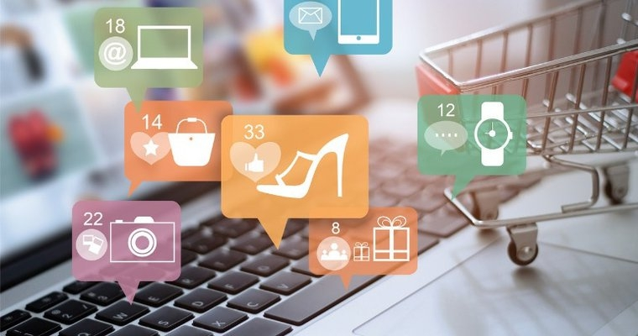

Market Basket Optimization

Slide 2


Group No: 04
Guided By:
Group Members:
Prof.Richa Agarwal.
1.Aditya More (IT3051)

Slide 3

Content
1. Introduction
2. Motivation
3. Scope
4. Objective
5. Problem Statement
6. Technologies Used
7. Outcome
8. Reference

Slide 4
Introduction
Market basket analysis is the most important topic for every online or offline retail business.
Market Basket Analysis is a technique applied by retailers to understand customer’s shopping behavior from their stores
It helps in increasing the sales and maintain inventory by focusing on the point of sale transaction data.
What is market basket analysis?
Add To Cart
Notes:
© Copyright Showeet.com – Creative & Free PowerPoint Templates

Slide 5
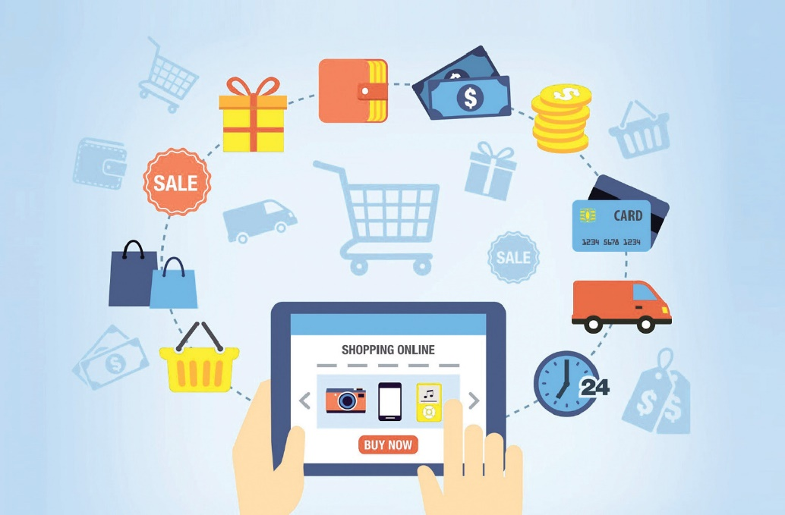
Recommendation System
Recommendation systems are kinds of systems for filtering information which analyse user behaviour data from past times and try to predict the user’s preference for item’s.
They focus mainly on individuals without personal experience and are not a differentiated group of customers.
Techniques used by recommendation engines can be:
Customer –based
Item-based

Slide 6

Motivation
Have you ever wondered how Amazon, Netflix and Spotify make product recommendations?
Market basket analysis is a technique that allow to discover the relationships between products.
It is based on searching for the most common combination of products in each transaction.
In our analysis we use the Apriori algorithm and the main goal is to sorting the products and creating the best relationship.

Slide 7


Scope
Cross Selling
Customer Behavior
Product Placement
Fraud Detection
Deliver online marketing Campaigns

Slide 8




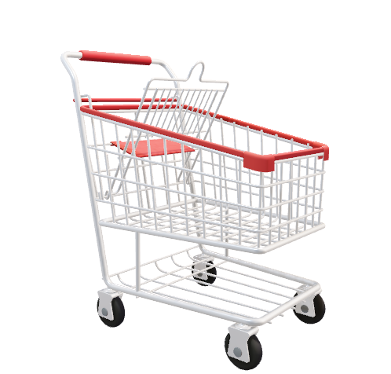
Objective
To improve sales
To understand the purchasing pattern
To recommend and suggest products to individual customers
Extend good relationship
To understand the customer’s shopping behaviour

Slide 9
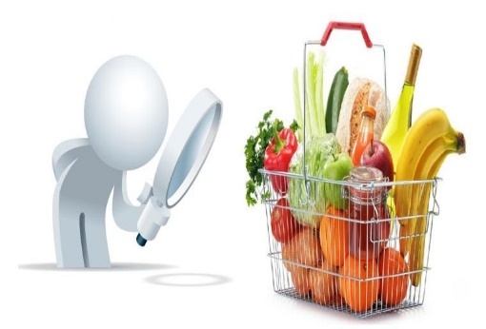
Problem Statement
Nowadays people buy daily goods from online e-commerce website where we can purchase products from nearby grocery shops. There are many supermarkets that provide goods to their customer. The problem many retailers face is the placement of the items. They are unaware of the purchasing habits of the customer so they don’t know which items should be placed together in their store. With the help of recommendation system we can predict which previously purchase products will be customers next order. Also decisions like which item to stock more, cross selling, up selling, store shelf arrangement are determined.

Slide 10
Technologies Used
1
1
Programming Language: Python
Technology
2
Google Colab Notebook
2. Google colab notebook
Data Exploration Tools
3
3
4
4
Visualisation Tools
5
Apriori Algorithm
6
Association Rule

Slide 11

Project Outcome
Increase product sales
Customer satisfaction
Offering best deals
Manufacturing new product according to customer needs

Slide 12
Reference
Sonu Mittal,Seema Chattani,2021,Comparative Analysis Of Marley Basket Analysis through Data Mining Techniques, https://ieeexplore.ieee.org/document/9410737
Maliha Hossain,Mahit Kumar Paul,2019,Market Basket Analysis Using Apriori and FP Growth Algorithm, https://ieeexplore.ieee.org/document/9038197/authors
Comparative_Analysis_of_Market_Basket_Analysis_through_Data_Mining_Techniques.pdf
Rece Reference
Market_Basket_Analysis_Using_Apriori_and_FP_Growth_Algorithm.pdf
Blog Links:
https://techbusinessguide.com/what-is-market-basket-analysis/
https://medium.com/analytics-vidhya/analysis-of-instacart-from-kaggle-competition-12a26a24ef4b

